Slide 1
AWS S3(Simple Storage service)

Slide 2
What is Amazon S3?
S3 = Simple Storage Service
A SOA which provides online storage using web services.
Allows read, write, and delete permissions on objects
Uses REST and SOAP protocols for messaging, so you can use various development toolkits with S3.

Slide 3
How it Works
Store data on Amazon’s distributed system containing multiple servers within Amazon’s data center locations
Data takes time to propagate
Can store it in North America or Europe
Amazon doesn’t offer you a GUI based tool to access your data. You can use one of the several tools online or build one through APIs

Slide 4
Advantages to Amazon S3
Amazon S3 is intentionally built with a minimal feature set that focuses on simplicity and robustness. Following are some of advantages of the Amazon S3 service:
Create Buckets – Create and name a bucket that stores data. Buckets are the fundamental container in Amazon S3 for data storage.
Store data in Buckets – Store an infinite amount of data in a bucket. Upload as many objects as you like into an Amazon S3 bucket. Each object can contain up to 5 TB of data. Each object is stored and retrieved using a unique developer-assigned key.
Download data – Download your data or enable others to do so. Download your data any time you like or allow others to do the same.
Permissions – Grant or deny access to others who want to upload or download data into your Amazon S3 bucket. Grant upload and download permissions to three types of users. Authentication mechanisms can help keep data secure from unauthorized access.
Standard interfaces – Use standards-based REST and SOAP interfaces designed to work with any Internet-development toolkit.
Note
SOAP support over HTTP is deprecated, but it is still available over HTTPS. New Amazon S3 features will not be supported for SOAP. We recommend that you use either the REST API or the AWS SDKs.

Slide 5
Amazon S3 - Components
Objects
The information you're storing.
Consist of
metadata
System Metadata – Request ID Headers, useful for Amazon staff
User Metadata - 2kb Max. Date last modified, file size, or anything else you would like.
Data (5GB Max)‏

Slide 6
Amazon S3 - Components
Buckets
Container.
Each object is inside of a container.
Buckets are owned by an AWS account
http://mybucket.s3.amazonaws.com
If you have a file called hi.txt in the above bucket, it would be stored in http://mybucket.s3.amazonaws.com/hi.txt

Slide 7
Amazon S3 - Components
Keys
Files are represented as unique keys within a bucket.
In reality the key is basically your file name
Example: http://bucket.s3.amazonaws.com/file.txt
file.txt is the unique key

Slide 8
Amazon S3 - Operations
Use either the REST or SOAP API to do the following and more
Create a bucket
Write an object
Read an object
Delete an object (Be careful not to rapidly create and delete an object)‏
List the keys (files)‏

Slide 9
Amazon S3 – Build your own APP Java Example Operations
// Access Key – Identified you as the requester. Associated with your // account, this is sent in plaintext in the message //Secret Access Key – Used to generate a signature, not sent as //plaintext AWSAuthConnection conn = new AWSAuthConnection("[aws-access-key-id]", "[aws-secret-access-key-id]"); Response response = conn.createBucket("[bucket-name]", null); if (response.connection.getResponseCode() == 200) { // bucket was created } else { // something bad happened }

Slide 10
Amazon S3 – Java Example Operations
// simple list ListBucketResponse response = conn.listBucket("[bucket-name]", null, null, null, null); List objects = response.entries; for (Iterator it = objects.iterator(); it.hasNext(); ) { ListEntry entry = (ListEntry)it.next(); System.out.println("key = " + entry.key + " size = " + entry.size); } // list only things starting with "foo" response = conn.listBucket("[bucket-name]", "foo", null, null, null); // list only things that come after "bar" alphabetically response = conn.listBucket("[bucket-name]", null, "bar", null, null); // only list 3 things response = conn.listBucket("[bucket-name]", null, null, new Integer(3), null);

Slide 11
Amazon S3 – Other Supported Languages
C#, Perl, PHP, Ruby, Python

Slide 12
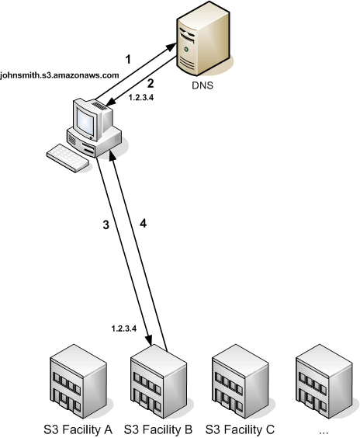
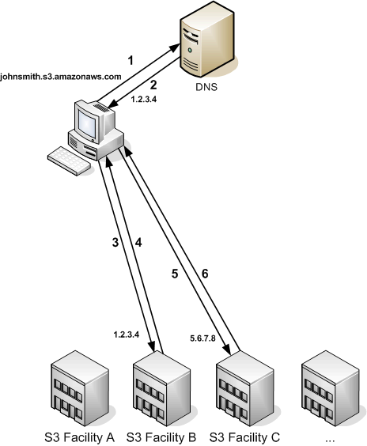
Amazon S3 – Other Options
Redirect Routing when route error

Slide 13
Cost
United States
Storage
$0.150 per GB – first 50 TB / month of storage used
$0.140 per GB – next 50 TB / month of storage used
$0.130 per GB – next 400 TB /month of storage used
$0.120 per GB – storage used / month over 500 TB
Data Transfer
$0.100 per GB – all data transfer in
$0.170 per GB – first 10 TB / month data transfer out
$0.130 per GB – next 40 TB / month data transfer out
$0.110 per GB – next 100 TB / month data transfer out
$0.100 per GB – data transfer out / month over 150 TB
Requests
$0.01 per 1,000 PUT, COPY, POST, or LIST requests
$0.01 per 10,000 GET and all other requests*
* No charge for delete requests

Slide 14
Summary
Amazon S3 is an easy to use service that allows us to store data on their facilities for a minimal cost, potentially using it for things like torrenting, web hosting, ftp app, online backups, etc.

